Slide 1
NATIONAL SEMINAR ON, “ADVANCES IN BIOLOGICAL SCIENCES RESEARCH” Nirmala College for Women, Coimbatore September 19 - 20, 2018
Participation by Students of I M. Sc. Zoology

Slide 2
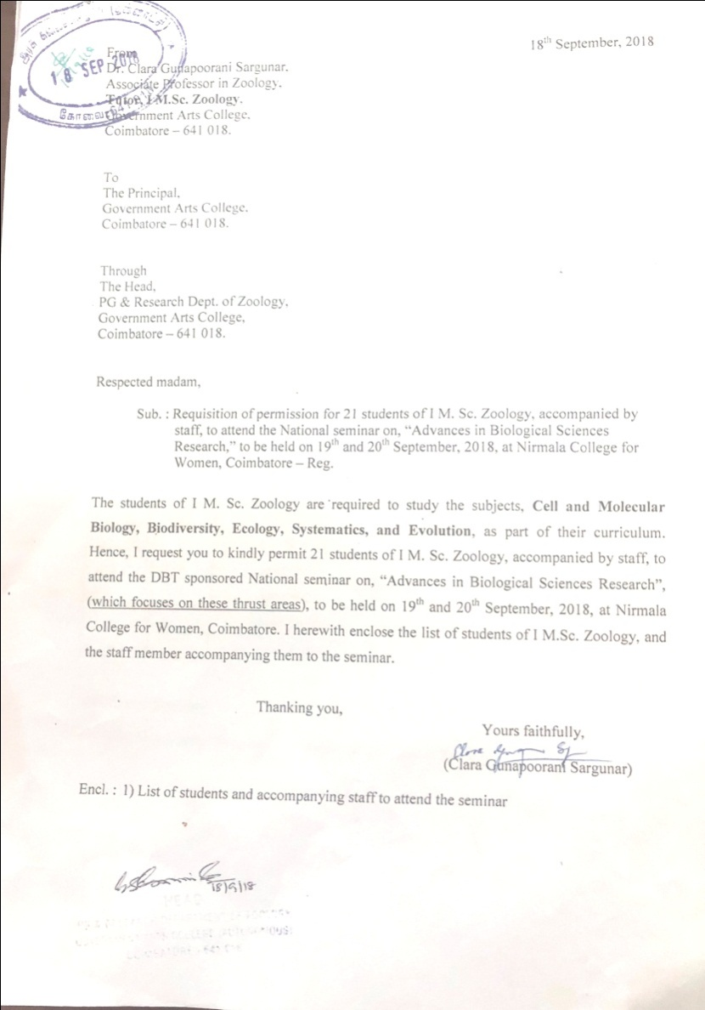

Slide 3
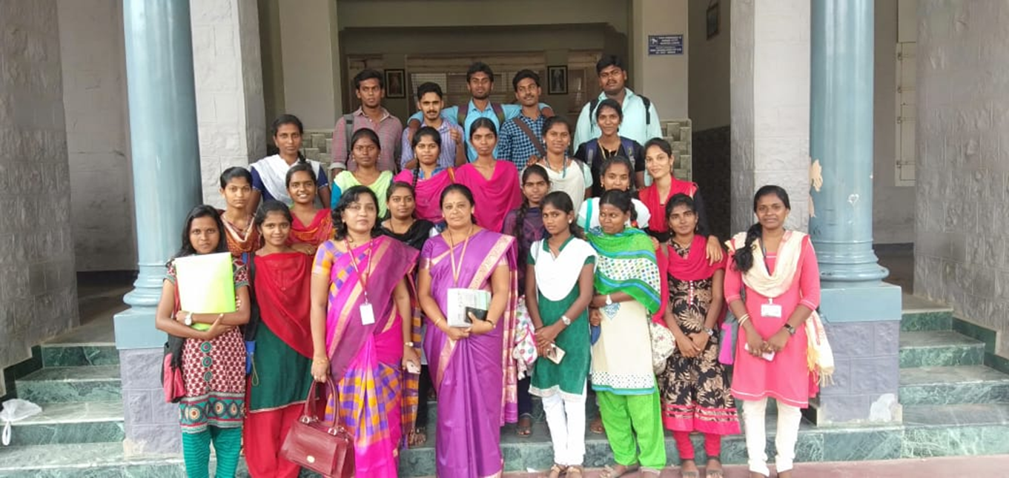
NATIONAL SEMINAR ON, “ADVANCES IN BIOLOGICAL SCIENCES RESEARCH”

Slide 4
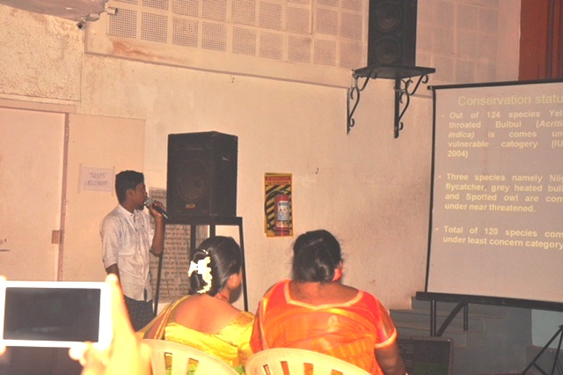
NATIONAL SEMINAR ON, “ADVANCES IN BIOLOGICAL SCIENCES RESEARCH”
Oral Presentation by Students

Slide 5
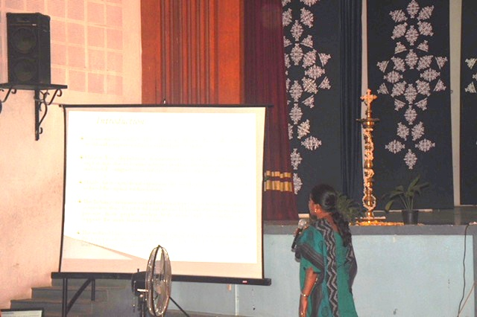
NATIONAL SEMINAR ON, “ADVANCES IN BIOLOGICAL SCIENCES RESEARCH”
Oral Presentation by Students

Slide 6
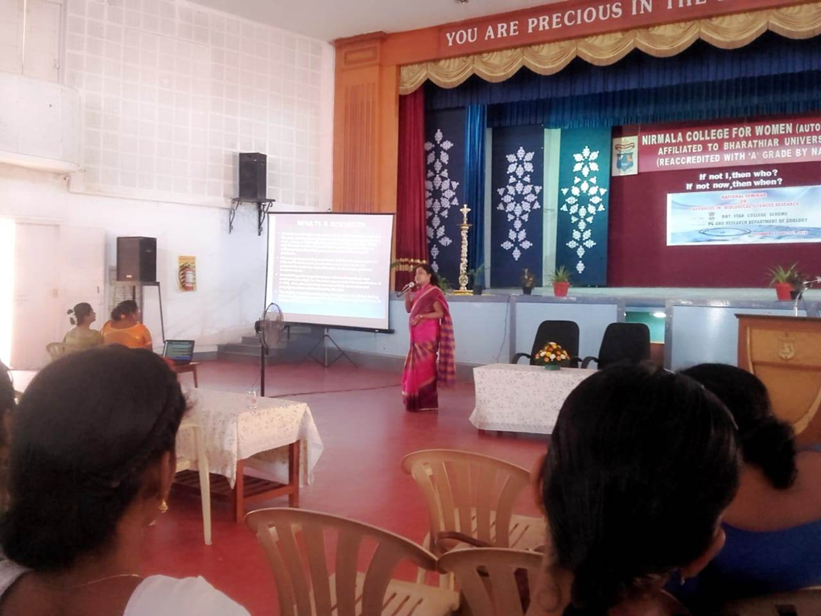
NATIONAL SEMINAR ON, “ADVANCES IN BIOLOGICAL SCIENCES RESEARCH”
Oral Presentation by Staff

Slide 7
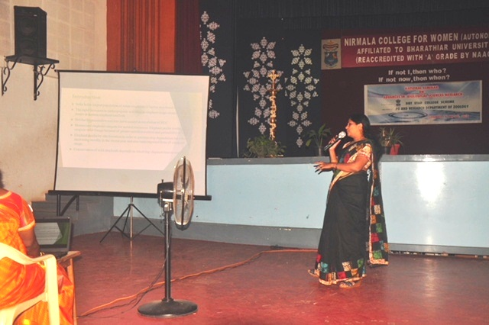
NATIONAL SEMINAR ON, “ADVANCES IN BIOLOGICAL SCIENCES RESEARCH”
Oral Presentation by Staff

Slide 8
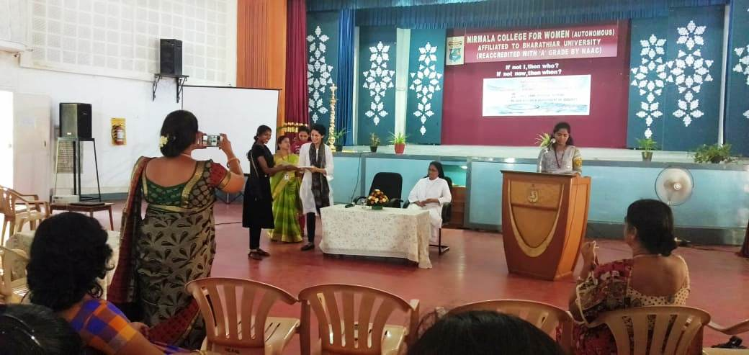
NATIONAL SEMINAR ON, “ADVANCES IN BIOLOGICAL SCIENCES RESEARCH”
Receiving the Certificates

Slide 9
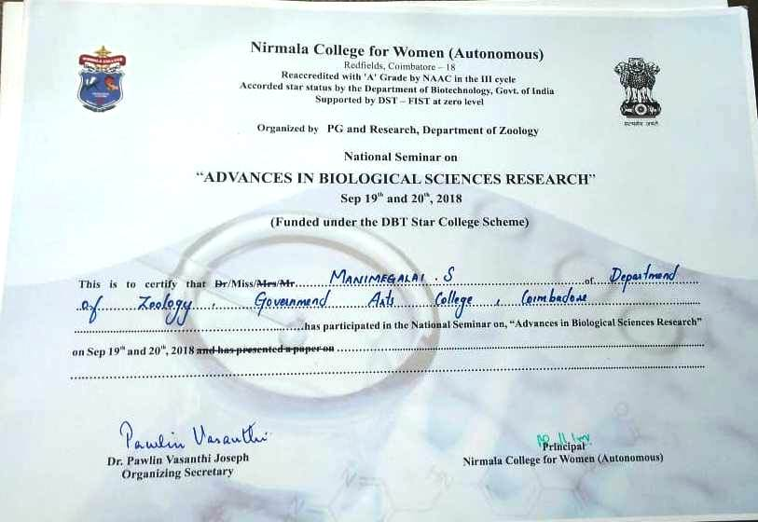
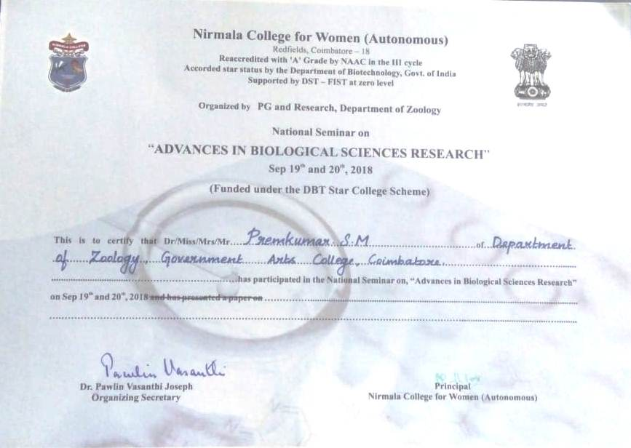
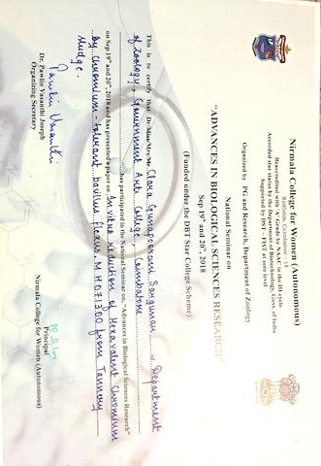
NATIONAL SEMINAR ON, “ADVANCES IN BIOLOGICAL SCIENCES RESEARCH”

Slide 10
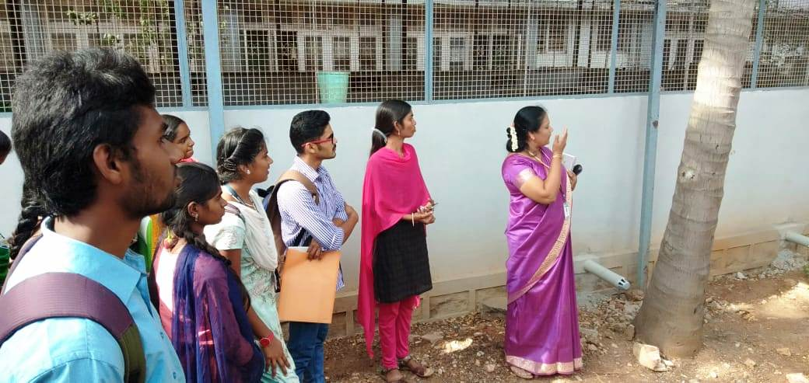
NIRMALA COLLEGE FOR WOMEN, COIMBATORE
Visit to the Vermicomposting Plant

Slide 11
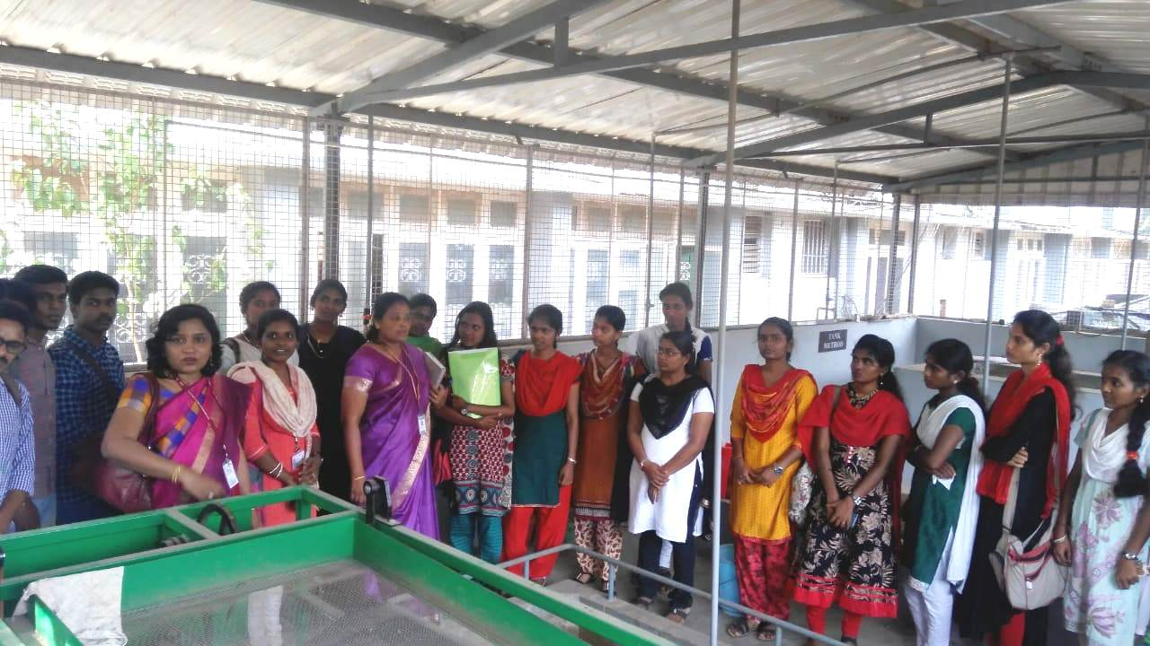
NIRMALA COLLEGE FOR WOMEN, COIMBATORE
Visit to the Vermicomposting Plant

Slide 12
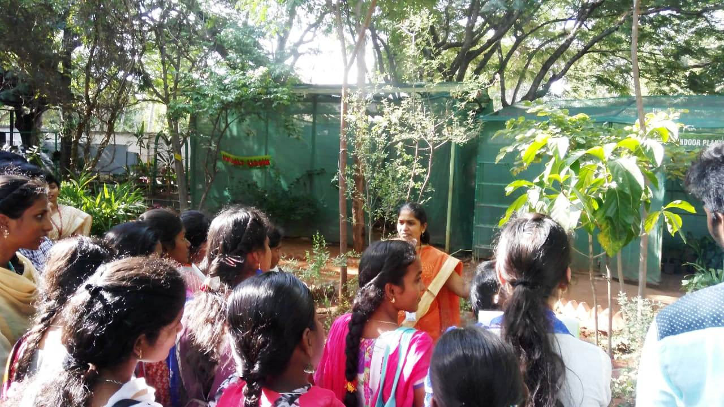
NIRMALA COLLEGE FOR WOMEN, COIMBATORE
Visit to Herbal Garden

Slide 13
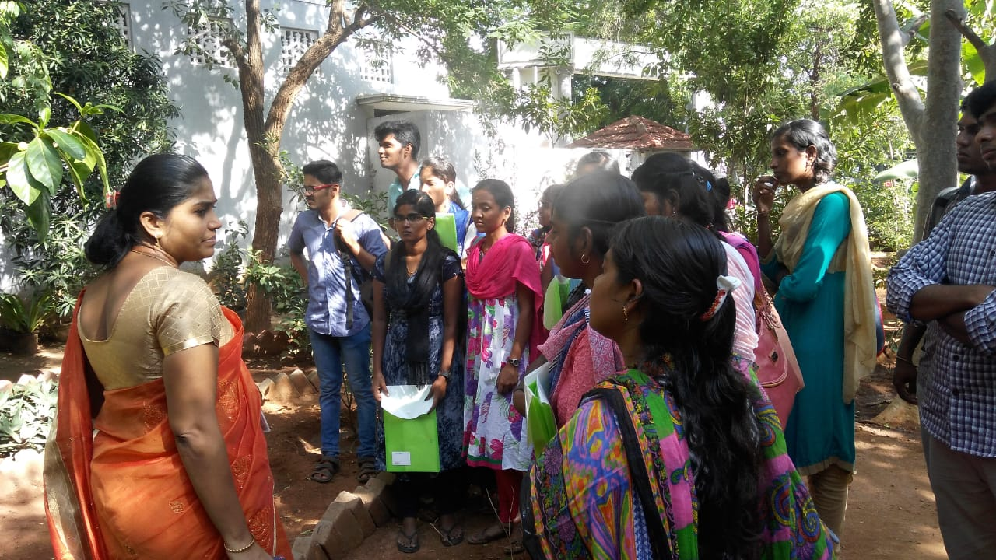
NIRMALA COLLEGE FOR WOMEN, COIMBATORE
Visit to Herbal Garden

Slide 14
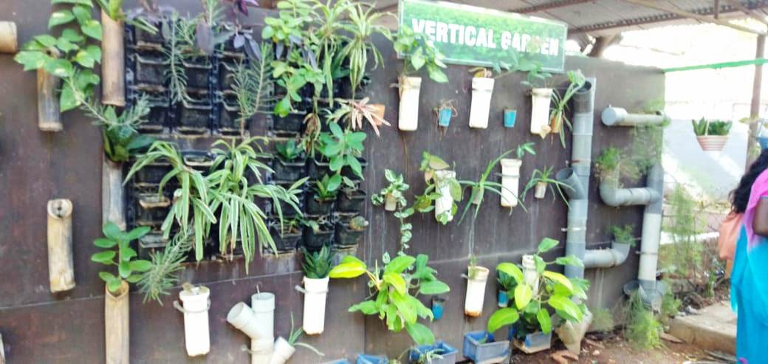
NIRMALA COLLEGE FOR WOMEN, COIMBATORE
Vertical Garden

